Slide 1
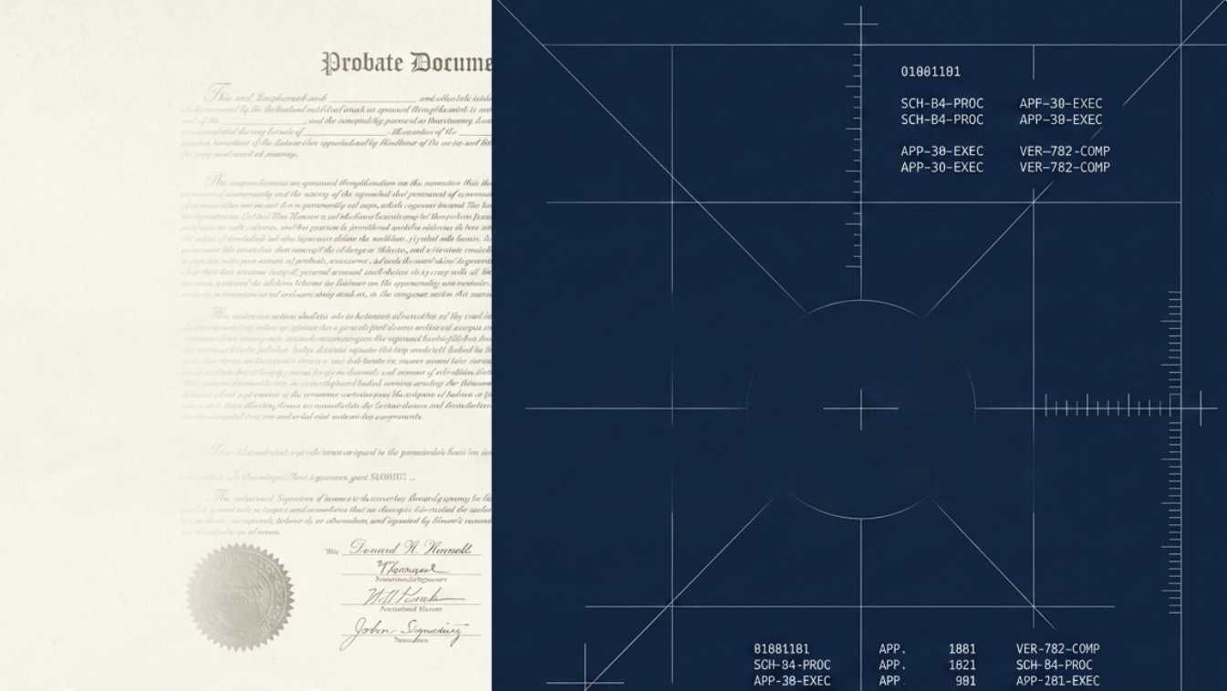



Trust and Verification in Estate Administration
Evaluating AI’s Current Reality, Future Horizon, and the Human Aspect
Notes:
Hello. Today we will take a look at AI in estate administration, specifically the work involved in administering an estate for a family member as a fiduciary.
This type of work is something that touches almost everyone at some point in their lives, yet the process is not typically known until you are handed the responsibility. Seeing how AI can support this work is especially interesting because it can potentially help untangle the complex web of probate requirements, which vary by state.

Slide 2

Current Status of AI In Probating an Estate for Fiduciaries
z
Helpful: Organizing large amounts of data into court-compliant formats. Reduced hours of data entry and organization.
Harmful: Dropping critical legal context. This could have been due to token limitations that the AI did not indicate any notification of, or a drop in context understanding.
Notes:
(add in about the U curve)
While working through the weekly assignments, I found that AI can be genuinely helpful when the task is primarily about organizing information, I also found a very important limitation, that is that AI can drop critical legal context when presented with large amounts of data to review.

Slide 3

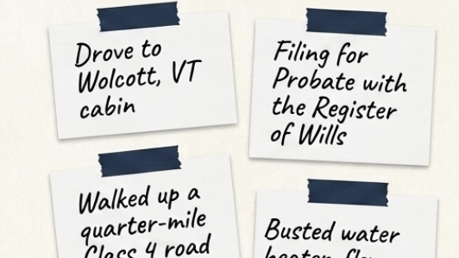
How time-heavy work becomes structured data.
z
Task: The AI was tasked with formatting and calculating travel and labor information into a Vermont Probate Court accounting table.
Provisions: The AI was provided with the ‘Probating a Vermont Estate Booklet’ for background and relevant details on start, stop, and end dates, times, and locations to build a graph showing time spent on estate-related tasks.
Outcome: The AI provided a clean, easy-to-read register of all dates, mileage, drive times, and time spent working on Estate tasks.
Where the human was needed: Drive time estimates in some places were significantly shorter than possible, necessitating human review before submission.
Notes:
For one assignment, I provided Copilot with the Vermont Probate Court booklet for background context
and dates, start and end locations, and details regarding estate-related tasks, such as cleaning out the cabin /going to the dump, meeting with real estate agents, purchasing and installing flooring, etc.
Then, I asked it to format and calculate the travel and labor information into a probate court accounting table.
The result was actually very useful. AI turned what was basically a messy collection of dates, locations, and details from my notes app into a clean, easy-to-read register. It organized the chart by date, and - calculated mileage, driving time, and work time in a way that could make the administrative process much less burdensome. This is a real place where I think AI can save some substantial time.

Slide 4
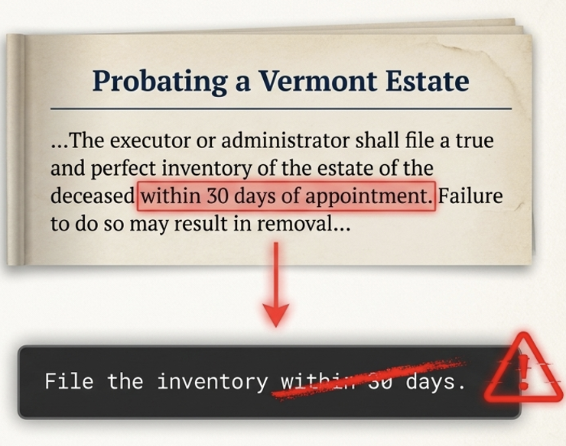
Unintentional Harms with Real Consequences
z
AI was tasked with outlining the duties for Administrators from the 11-page Vermont Probate Estate Booklet
What Went Wrong?
AI dropped crucial context, which materially changed the expectations of when an inventory of assets should be submitted to the court
What is the Harm?
30 days from death vs. 30 days from court appointment are significantly different timelines, one of which could have the fiduciary removed by the court from acting on behalf of their loved one.
Notes:
In another assignment, outlining the duties of an administrator based on the Vermont Probate Estate Booklet, copilot dropped a crucial piece of legal context. Specifically, it changed the meaning of when an inventory of assets needed to be submitted to the court. The distinction was between 30 days from the date of death and 30 days from the date of court appointment.
That sounds like a small difference, but it absolutely isn't.
The difference plays out like this: 30 days from death, you've contacted a funeral home, written an obituary, contacted family, made hundreds of tiny decisions, most likely haven't received the death certificate yet to even begin probate, let alone the grieving process- AND now you have to inventory their entire life? An almost unthinkable task.
30 days from appointment spells out a very different timeline, as you have retained counsel, recieved the death certificate, and hopefully had some time to process
So my firsthand takeaway is that AI can be very good at turning messy information into structured information, but that does not mean it reliably understands the significance of every piece of information it is given. In estate administration, dropping one important detail can be much more consequential than making a formatting mistake.

Slide 5

Copilot Predicts the Next 24 Months of Estate Administration
Copilot claim: “Expect AI‑driven intake, automated inventory building, probate/trust document generation, meeting‑note extraction, beneficiary communications, and tax‑sensitive modeling to become standard. Firms will see 30–50% reductions in drafting and administration time.”
Notes:
Pivoting into looking at the future of estate adminstration, I requested Copilot to predict what AI would look like in estate administration over the next 24 months.
"What is coming for AI in the field of estate administration and estate administration tasks for individuals in the next 12–24 months?"
The specific claim I chose to test was:
Firms will see 30–50% reductions in drafting and administration time.”
I wanted to focus on the 30-to-50-percent number because it sounded specific enough that I should be able to trace it to an actual source.
https://happycapyguide.com/blog/how-to-use-ai-for-estate-planning-law-firm-2026?utm_source=copilot.com

Slide 6
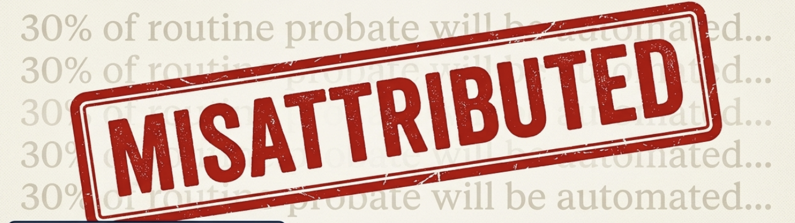
Findings:
In attempting to search for the 30-50% reduction metric, Copilot let me to Happycapy guide, “How to Use AI for an Estate Planning Law Firm in 2026: A Pragmatic Managing-Partner's Playbook,”- where I was able to find the 30-50% metric, however, the actual claim states states: 30—50% reduction in drafting time in response to a question regarding an estate planning firm rolling out AI for a 1-25 person headcount.
Notes:
When I tried to verify it, Copilot led me to an article called “How to Use AI for an Estate Planning Law Firm in 2026: A Pragmatic Managing-Partner's Playbook,” from Happycapy Guide. I was able to find the 30-to-50-percent figure there, but the important thing is that the original claim was narrower than the way Copilot presented it. (Happycapy)
The source was talking about a 30-to-50-percent reduction in drafting time in response to a question about an estate planning firm implementing AI with a one-to-25-person headcount.
That is not the same thing as evidence that estate administration generally will see a 30-to-50-percent reduction in drafting and administration time.
So my verdict is misattributed.
The number wasn't simply fabricated out of nowhere. I found a source containing the number. But Copilot broadened and changed the context of the claim. It essentially took a statistic about drafting time in a particular estate-planning-firm scenario and presented it as support for a much broader prediction about estate administration.

Slide 7
What to tell Others?
In this unique aspect of life, ‘colleague’ doesn’t quite fit the bill, but almost everyone encounters this duty in life, so it is applicable to all.
I would tell someone who repeated that claim that it refers to legal professionals, not administrators completing work on behalf of family members, and that it had to do with drafting responses, for example, to questions that administrators would send to legal professionals.
Notes:
So, what would I tell others if they presented that statistic to me? I wouldn't really say there are 'colleagues' in the typical sense of this important work, but if another person either currently going through this process or expects to in the near future repeated that claim to me, let's say in a coffee meet up to ask best practices or the like, I would say: “I would be careful with that number. I was able to trace it to a source, but it doesn't support the field of estate administration, it supports drafting - for the legal team responding to us or the courts on our behalf. A claim having a number attached to it doesn't automatically make it reliable, so we shouldn't use that statistic as evidence without qualifying it. The number itself needs to be traced back to what the original source actually said.

Slide 8

What’s Not Changing?
Humans will always be needed
Estate Administration will continue to require a human; AI cannot be held responsible or liable for legal liability.
Family members understand the sentimental value and meaning attributed to their duties; AI cannot replicate that type of human judgment.
A human will need to physically sort through belongings left by a loved one, distributing them as requested, and clearing out things left behind, so that is a major aspect of my work that will still need a person.
Notes:
Most importantly, a human will always be needed for the actual administration of an Estate.
There are certainly parts of this work that AI could help with, like organizing records, creating lists, or helping prepare information. But AI cannot be responsible or legally liable for decisions made on behalf of an estate.
There is also a human dimension that I don't think AI can reasonably proxy. Family members understand the sentimental value and meaning attached to belongings in a way that an AI system cannot. A person will need to physically sort through the belongings of someone who has passed, determine what should be distributed according to the will (if one exists), what should be kept, and what needs to be cleared out.
Those decisions aren't simply data-processing problems. They involve relationships, ambiguity, responsibility, and processing grief.

Slide 9
Final Thoughts
AI can help with burdensome mundane tasks, but it must be checked for hallucinations and dropping important details
AI can confidently produce incorrect figures that must be independently checked. Using the S.I.F.T. method helps here.
When managing the affairs of a loved one, hands-on management is irreplaceable. Complex ambiguity, physical cleanout and distributions, and legal liability remain in the hands of a human.
Notes:
Overall, I think AI will probably become much more useful in estate administration, particularly for the tedious organizational work. But my experience has made me much less willing to assume that more capable AI means less need for human judgment.
AI can help with the burdensome, mundane parts of the job. But when the consequences of getting something wrong are significant, the human still needs to check the work, understand the context, and ultimately take responsibility for the decisions.

